Slide 1
Prognosis of the energy price mainly based on solar energy in Germany
A comparison of Random Forest, Gradient Boosting und XGBoost

Slide 2
Structure
Introduction
Data Collection & Cleansing incl. Visualization
Three ways for regression - Comparison
Regression Model and Results
Analysis of our Results
Finetuning
Improvements

Slide 3
How was our procedure? - Introduction
Data collection
& cleansing
Creation of three
regression models
Analysis & Finetuning
1.
2.
3.
Our Data → Focus: Solar energy
Day-Ahead Total Load FC
Actual Total Load
Day-Ahead Solar generation FC
Actual Solar Generation
Sun hours
Day-Ahead generation Last (w/o Solar)
Electricity Prices
Our regression models:
Random forest
Gradient Boosting
Extreme Gradient Boosting
Our analysis:
Hyperparameter Tuning & Cross-Validation
Feature Importance
Adjustments of the Modell
  Dummy variable
  Adding explainable variable
Comparative indicator: R²

Slide 4
Model assumptions
Merit Order assumption
Renewable energy → lowest cost, lower energy price¹
Solar power easy to relate to weather conditions
Wind energy more complex
1 Vgl. Hirth (2022).

Slide 5
Data collection & cleansing
Day-Ahead Total Load FC
Sources: Deutscher Wetterdienst, Frauenhofer ISE, entso-e Transparency platform, EMBER
Actual Total Load
Day-Ahead Solar generation FC
Standardization → Monthly basis
Reason: Sun hours just available per month or per hour
Including all data in one file for further processing
Actual Solar Generation
Sun hours
Day-Ahead generation Last (w/o Solar)
Data Visualization
Electricity Prices

Slide 6
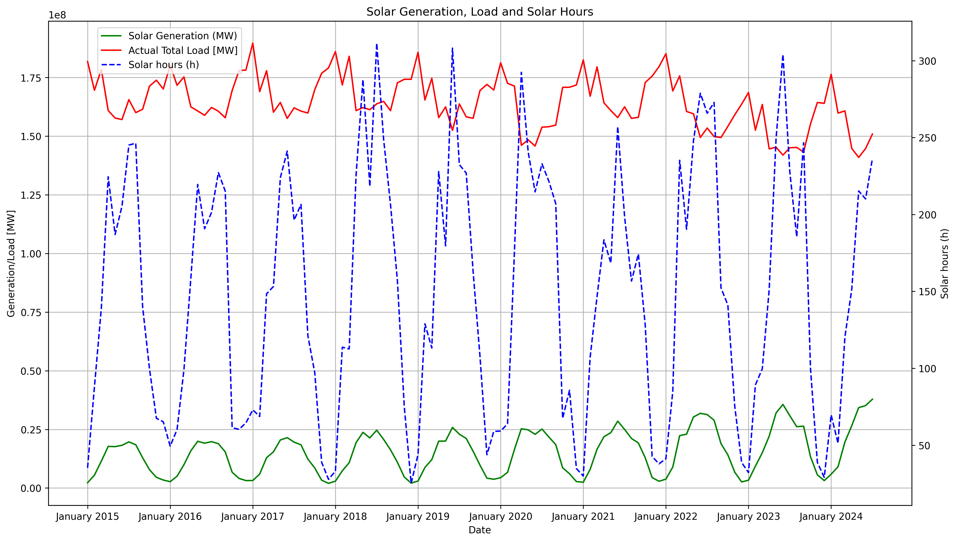
How did our data look like?

Slide 7
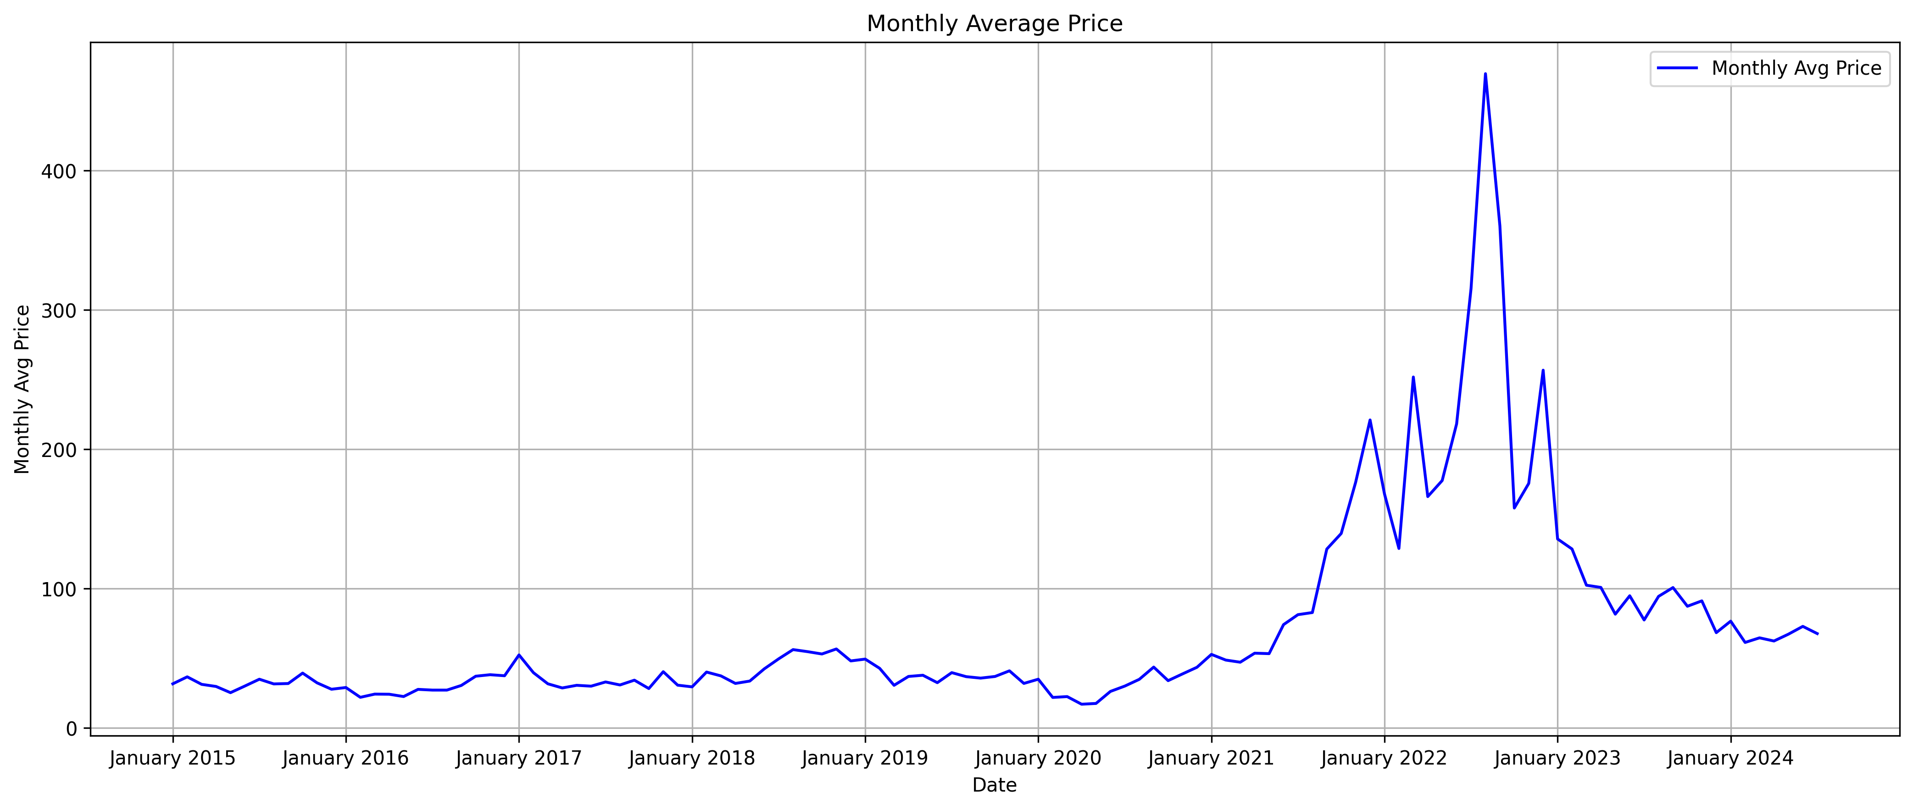
How did our data look like?

Slide 8
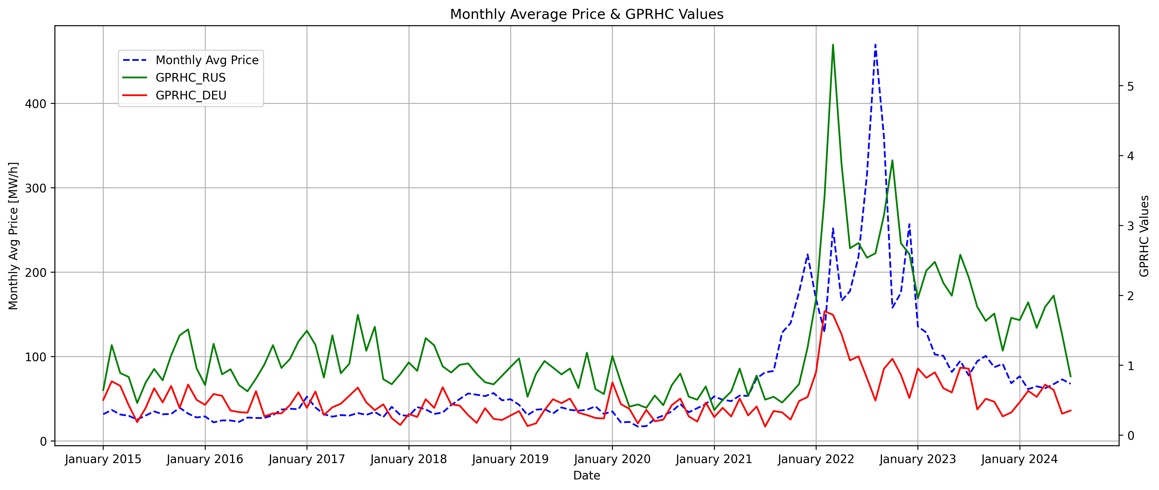
How did our data look like?

Slide 9
Comparison to other studies:
Sgarlato/Ziel (2023): meterologic data improves electricity price forcasts, Germany, LASSO and matrices
Trebbien et al. (2022): effect of renewable energy on the merit order, Germany, XAI machine learning, SHAP, GBT
Contreras et al. (2003): autoregressive model, prediction based on historical data
Lucas et al. (2020):explain and forecast the price behavior of a multi-variable regression model, Great Britain, GB, RF and XGBoost
Kumar Jana & Kumar Paul (2023): hour ahead forecast of electricity prices, Spain, linear regression, XGBoost, CNN (Convolutional Neural Network ), RNN (Recurrent Neural Networks), stacked RNN, LSTM, stacked LSTM etc.

Slide 10
Separation of the three used models:
Random Forest
Gradient Boosting
XGBoost
Combines multiple decsion trees to enhance accuracy and robustness
Final predictions are made thorugh averaging
Hyperparameter got tuned with gridsearch
Computes descision trees that learn from each other
Computes a strong learner from multiple weak learners
accuracy and performance are unmatched for tabular supervised learning tasks
Optimized version of gradient boosting
  Speed
  Efficiency
Regularization of model complexity (L1 and L2 regularization)
Parallelization (efficient computing time)
Out-of-core computing (good for huge data sets)

Slide 11
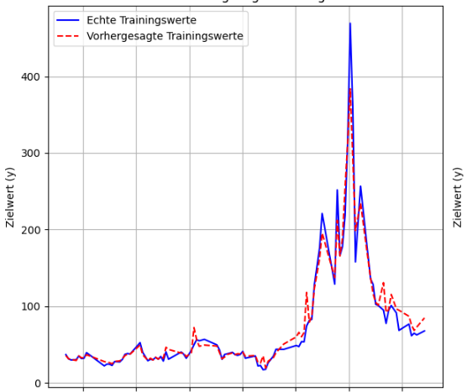
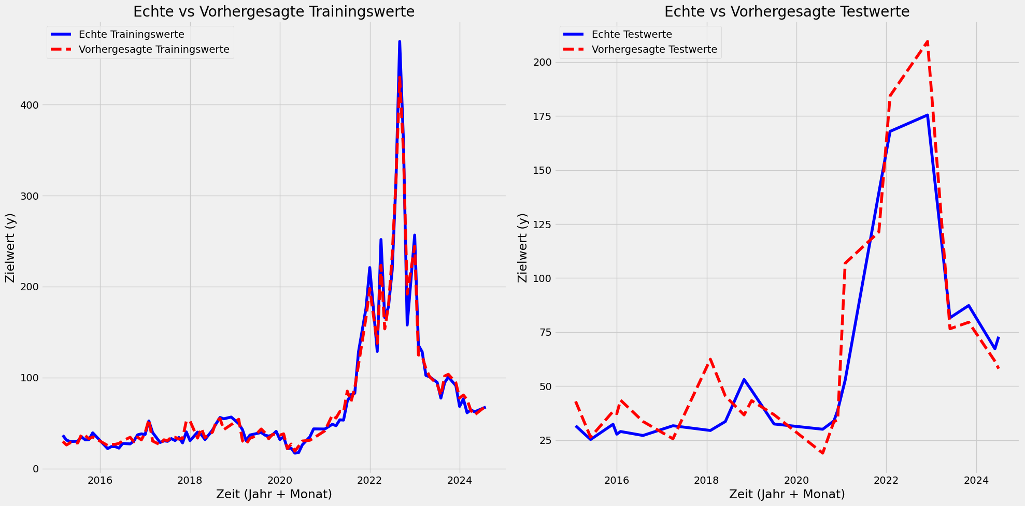
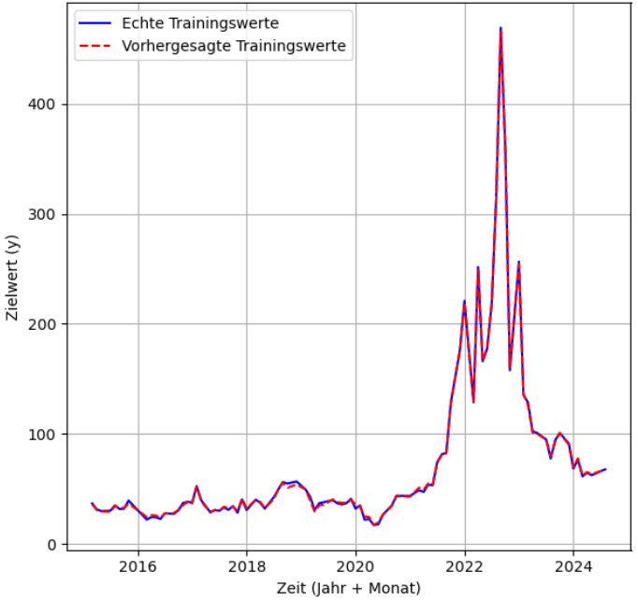
What did our regression model look like?
Electricity Price = b₀ + b₁ * Day-Ahead Load + b₂ * ACT Load + b₃ * Day-Ahead Solar gen. + b₄ * ACT Solar gen. + b₅ * Sun hours + b₇ * Day-Ahead gen. Last (w/o Solar) + b₈ * Date
Performance on training data:
Random Forest
Gradient Boosting
XGBoost
R² = 94%
R² = 99,86%
R² = 99,63%

Slide 12
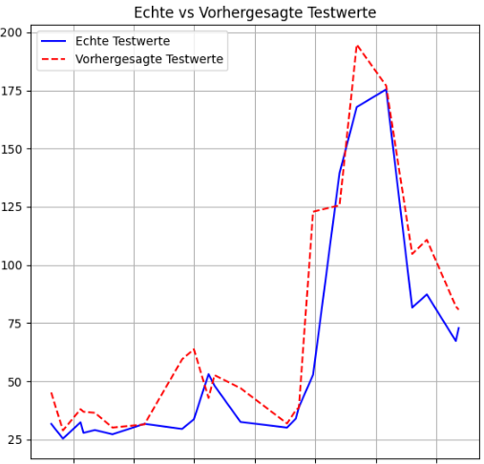
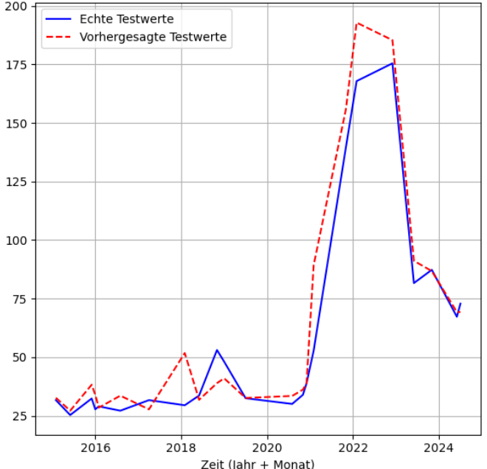
Our Results:
Performance on test data:
Random Forest
Gradient Boosting
XGBoost
R² = 77%
R² = 86,40%
R² CV = 40,52 %
R² = 92,4%
R² CV = 49,78%
R² CV= 44,08%
XGBoost best Performance on test data due to highest R²!

Slide 13
Further analysis: 1. Hyperparameter Tuning
Random Forest
Gradient Boosting
XGBoost
Best Parameters found¹:
Estimator: 20
Max depth: 15
Min samples split: 4
Max features: sqr
learning_rate: 0.1 max_depth: 3
n_estimators: 100
Learning rate: 0,2
Max_depth: 3
N estimators = 150
R²
R² CV
R² = 53%
R² CV = 53%
R² = 83,53% (from 86,40%)
R² CV = 60,27% (from 40,52 %)
R² = 75,2% (from 92,4%)
R² CV = 56,03% (from 49,78%)
¹ used Gridsearch for optimized Parameters (Gökçe et al. (2022), P. 4)
Due to high dependence on test set R² CV optimized

Slide 14
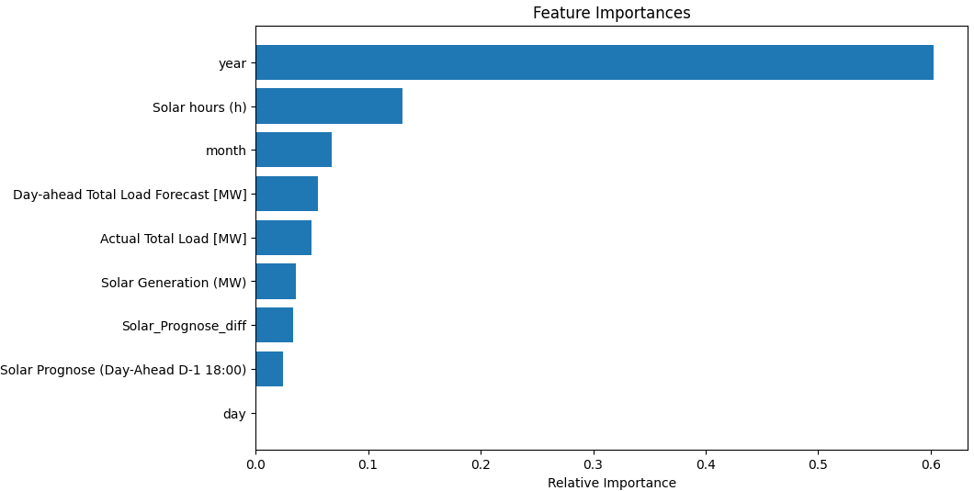
Further analysis: 2. Feature Importance

Slide 15
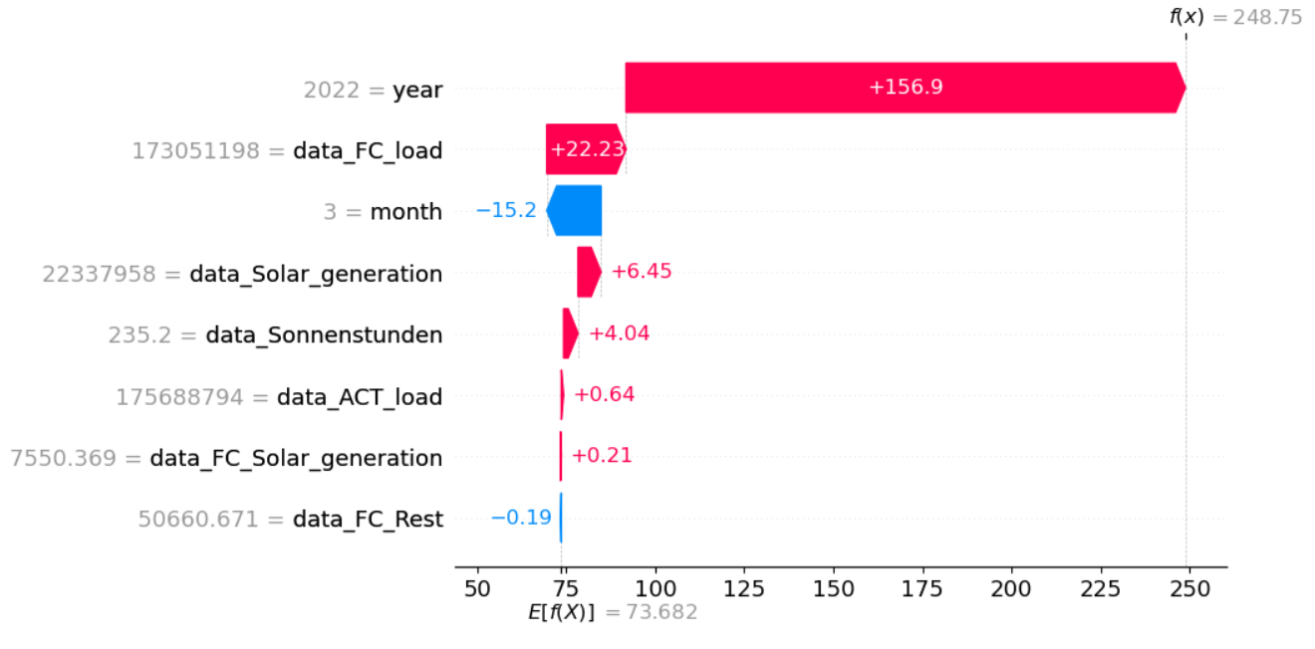
Feature Importance - outlier
Comments:
Analysis based on SHAP (SHappely Additive exPlanation) Values
  Concept of game theory to identify the contribution of every single feature
Year biggest impact on value
  Mean prognosis: 73,668
  Actual prognosted value of 248,75
  → Impact of 157 mainly caused due to year
Based on Lundberg (2017), p.1 f.

Slide 16
Adjustments
Initial Model:
Electricity Price = b₀ + b₁ * Day-Ahead Load + b₂ * ACT Load + b₃ * Day-Ahead Solar gen. + b₄ * ACT Solar gen. + b₅ * Sun hours + b₇ * Day-Ahead gen. Last (w/o Solar) + b₈ * Date
signals the one-time effect of Ukraine war ¹
Problem: not optimal for a small data basis
XGBoost: Further CV-R² Improvement to 66,8%
Dummy for period: 2022-2023
Dummy Variable
GPR (Geopolitical Risk Index)
  War potencial by counting key words e.g. „War“ and assuming the connected riks
Extracting effect by including GPR
Too high feature importance of the date → biased by the ukrainian war (price detemermined by political regulations)
¹ Based on: Sgarlato/Ziel (2023), p.18

Slide 17
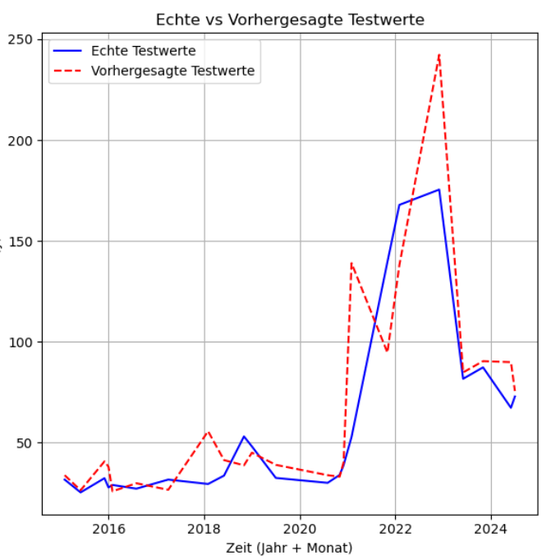
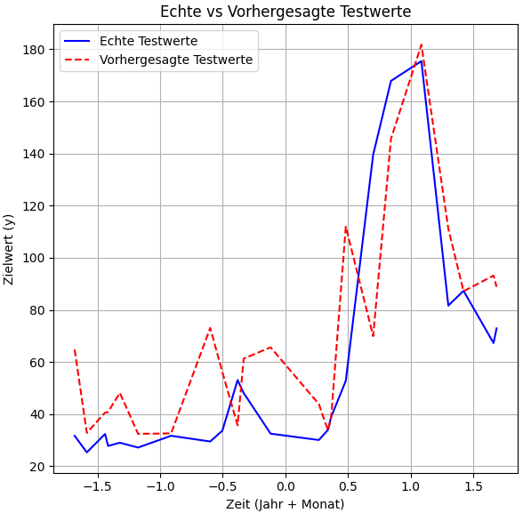
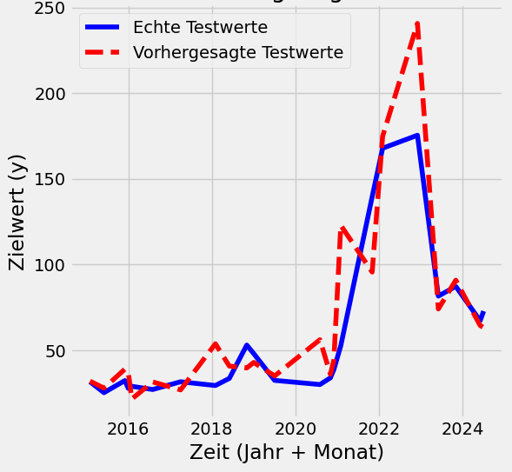
The adjusted regression model
Electricity Price = b₀ + b₁ * Day-Ahead Load + b₂ * ACT Load + b₃ * Day-Ahead Solar gen. + b₄ * ACT Solar gen. + b₅ * Sun hours + b₇ * Day-Ahead gen. Last (w/o Solar) + b₈* Date + b₉ * GPR Germany + b₁₀* GPR Russia
Performance on test data:
Random Forest
Gradient Boosting
XGBoost
R² = 56%
R² = 60,39%
R² = 62,29%

Slide 18
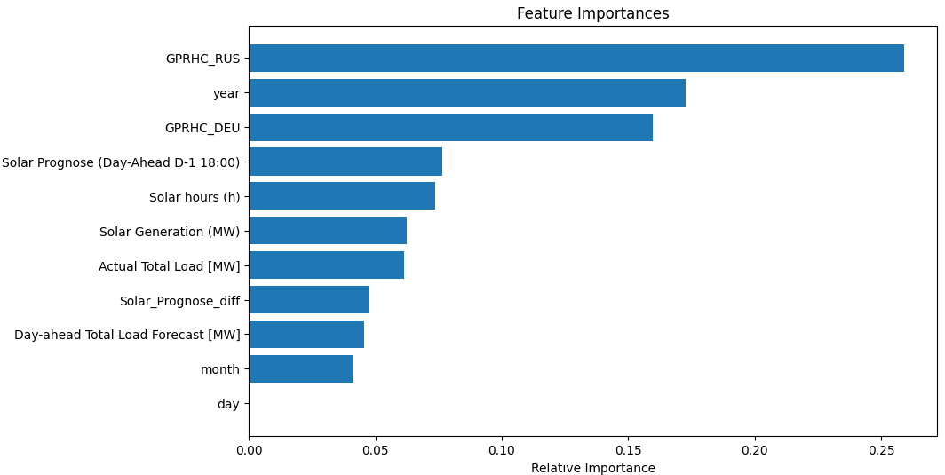
Analysis adjusted model: Feature Importance
Comments:
The GPRHC_RUS variable shows the highest feature importance.
The political effects were isolated from the 'year' variable.
Despite this, the 'year' feature still holds high importance, likely due to other unaddressed factors.

Slide 19
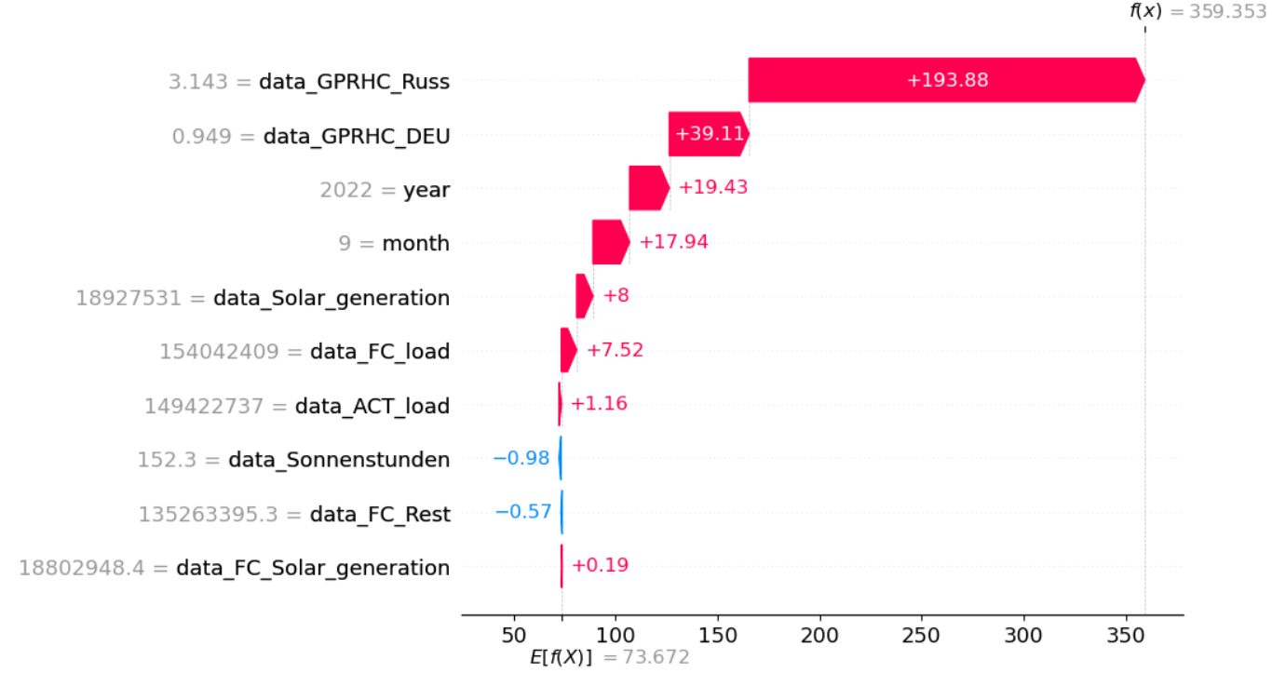
Feature Importance – outlier adjusted model
Comments:
Biggest impact not based on the date anymore
Moved to GPR from Russia and Germany
  Fits more real-world
  Still not all impacts from date identified
¹ Paper xxx

Slide 20
Limitations / Improvements
Daily / monthly basis not yearly
More Data
Include calendar and seasonal effects (holiday, weekend)
Weather data like cloud cover, irradiance that influence PV plants, temperature influences load
Location data, temperature higher in denser areas
Data:
Finetuning for our adjusted Modell
  Hyperparameter Tuning
  Cross Validation
Further extracting impacts out of the date
  e.g. Inflation​
Model:
Difficult to prognose electricity prices per month
Market more determined by political regulations than weather or electricity demand, especially in the long term
XGBoost regression achieved best results
General:

Slide 21
Literature Sources
Contreras, J., Espinola, R., Nogales, F., Conejo, A., (2003). ARIMA models to predict next-day electricity prices. In IEEE Transactions on Power Systems 18 (pp. 1014–1020).
Gökçe, M. M., & Duman, E. (2022, December). Performance comparison of simple regression, random forest and XGBoost algorithms for forecasting electricity demand. In 2022 3rd International Informatics and Software Engineering Conference (IISEC) (pp. 1-6). IEEE.
Hirth, L. (2022). The Merit Order Model and Marginal Pricing in Electricity Markets. Neon energy. https://neon.energy/marginal-pricing (22.09.2024, 21:09).
Kumar Jana, A., Kumar Paul, R. (2023). Performance Comparison of Advanced Machine Learning Techniques for Electricity Price Forecasting. In 2023 North American Power Symposium (NAPS). IEEE.
Lundberg, S. (2017). A unified approach to interpreting model predictions. arXiv preprint arXiv:1705.07874.
Lucas, A., Pegios, K., Kotsakis, E., Clarke, D. (2020). Price Forecasting for the Balancing Energy Market Using Machine-Learning Regression. In 2020 Energies, 13, 5420. doi:10.3390/en13205420
Sgarlato, R., Ziel, F. (2023). The Role of Weather Predictions in Electricity Price Forecasting Beyond the Day-Ahead Horizon. In IEEE TRANSACTIONS ON POWER SYSTEMS, Vol. 38, No. 3 (pp. 2500-2511).
Trebbien, J., Rydin Gorjao, L., Praktiknjo, A., et al. (2022). Understanding electricity prices beyond the merit order principle using explainable AI. In Energy and AI, Volume 13, July 2023, 100250. Elsevier.

